Slide 1
Road Accidents Data Analytics
Dataset Analysis & Visualization using PySpark
Abhijith Varma
2211CS010007
Mail id: abhijithvarma529@gmail.com

Slide 2
Dataset Information
- Dataset Source: https://github.com/abhijithvarma29/Big-Data-Analytics/blob/main/Road_Accidents.csv
- Number of Records: 868 rows
- Columns:
• STATE/UT: State or Union Territory where accidents were recorded
• YEAR: Year of the record
• JAN–DEC: Monthly accident counts
• TOTAL14: Annual total accidents
• 0–3 hrs to 21–24 hrs: Accidents by time of day
- Objective: To analyze accident trends, identify high-risk regions and time slots, and support policy-making for improved road safety.

Slide 3
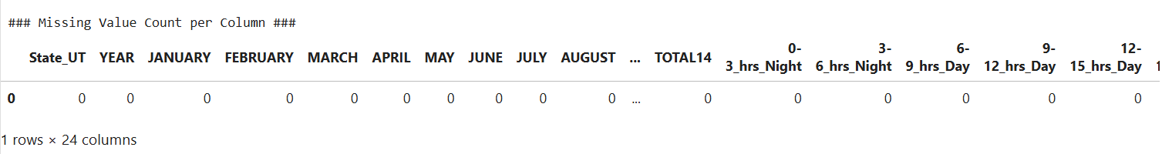
Initial Analysis
- Checked for missing or invalid values → None found
-Cleaned and standardized column names for ease of analysis
-Converted data types where necessary
-Dataset ready for visualization and exploration

Slide 4
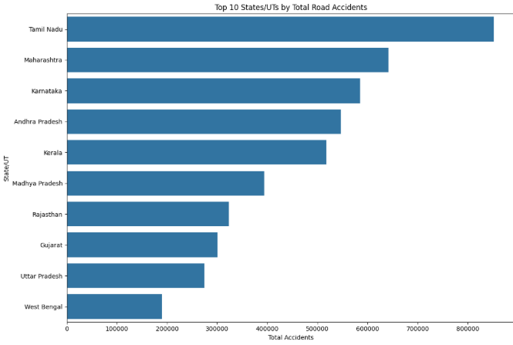
Accident Distribution
Insights:
Tamil Nadu, Maharashtra, and Uttar Pradesh report highest accident counts
Northeastern states show lower accident frequencies
Clear state-level disparities in road safety outcomes

Slide 5
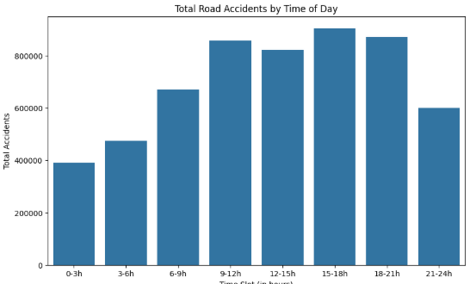
Time-of-Day Accident Analysis
Bar chart (Accidents vs. Time Slots)
Explanation:
Shows number of accidents across 8 time intervals
Insights:
Peak accidents between 15–21 hrs (evening traffic)
Significant number of night-time accidents (0–6 hrs) due to poor lighting and driver fatigue

Slide 6
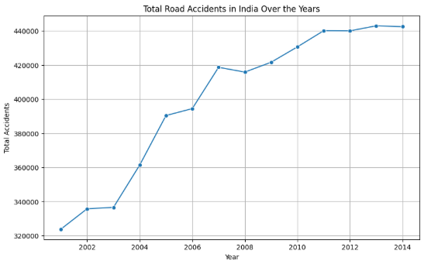
Yearly Trend of Accidents
Chart: Line plot of Total Accidents (2001–2014)
Insights:
Accidents fluctuate yearly
Some years show spikes possibly due to urbanization and increased vehicle count

Slide 7
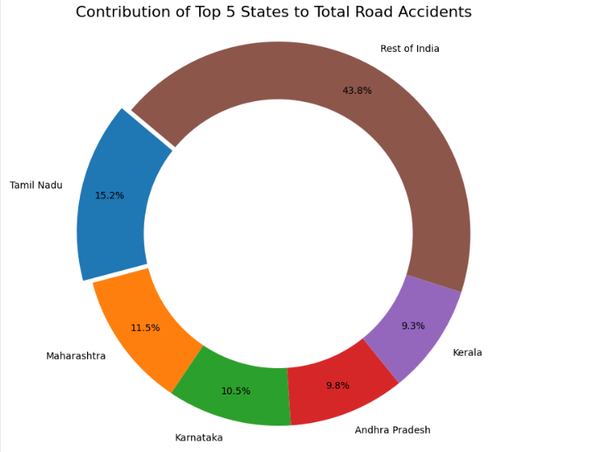
State-wise Comparison
Insights:
Tamil Nadu remains highest across most years
Southern and highly urbanized states face consistently higher risk

Slide 8
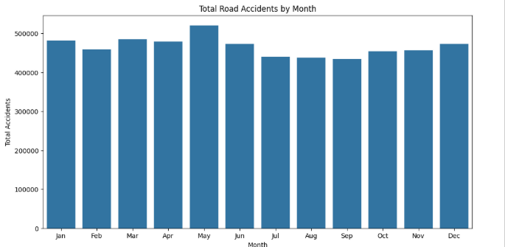
Monthly Distribution of Accidents
Insights:
May records the highest number of accidents (~520,000).
Accident numbers remain high from January–June, then slightly dip in July–September.
The rise again in November–December, possibly linked to festival seasons and increased travel.
Indicates a seasonal pattern in accident occurrence.

Slide 9
Conclusion
Findings:
Southern states and metro regions dominate accident statistics
Evening/night accidents are most frequent
Correlation between traffic volume, population, and accident risk
Implications:
Strengthen night-time monitoring and lighting
Implement targeted awareness campaigns
Improve road infrastructure and traffic regulation enforcement

